Slide 1
Stride for Stride for skills adaptation/anticipation in European Regions
S4S Tuscany workshop
ConnActions
Miriana Bucalossi

Slide 2
ConnActions Tuscany: key ecosystems and their ConnActions
Cultural Heritage
CH and Building ecosystem
Wine and Tourism
Wine ecosystem
Artistic and traditional crafts
Crafts ecosystem
Innovation, sustainability
Life Sciences ecosystem

Slide 3
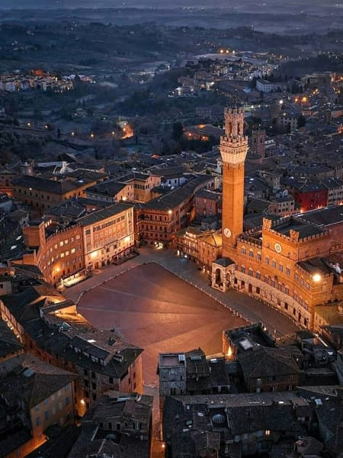
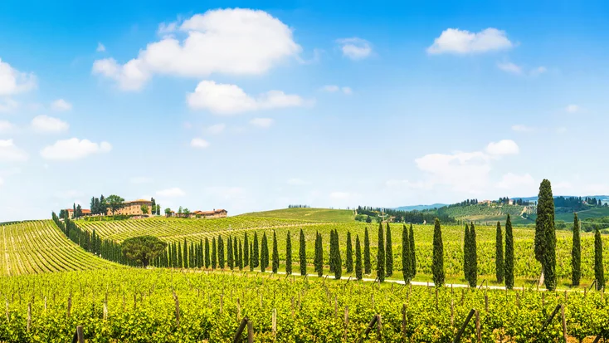
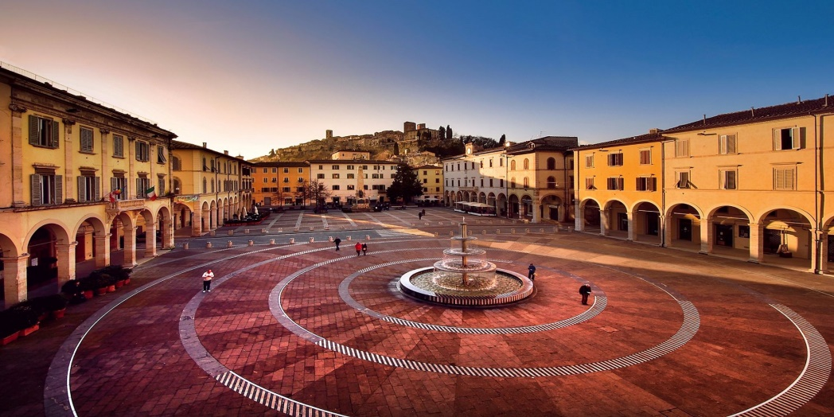
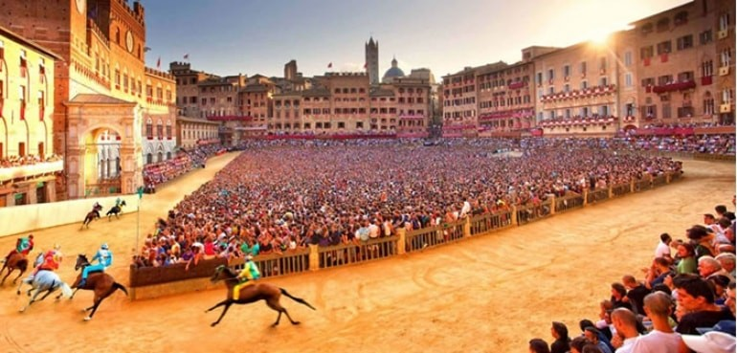
Where locations
Florence, Colle di Val d’Elsa, Siena
Chianti, Valdorcia

Slide 4
Draft Program locations
25/9 | 26/9 | 27/9 | 28/9
10-12 BOARD + GA – FLORENCE | 9 am (LIFE SCIENCES ECOSYSTEM) ITS VITA TOSCANA LIF SCIENCES FOUNDATION | WINE ECOSYSTEM VISIT | 8 am MOVING TO COLLE DI VAL D’ELSA
Moving to Scandicci | 11 am (CH ECOSYSTEM) LICEO ARTISTICO DUCCIO DI BUONINSEGNA | MORE DETAILS WILL FOLLOW ☺ | 9 am (CRAFTS ECOSYSTEM) Colle VILCA: the art of CRYSTAL BLOWING ARTEX
13 Lunch (CRAFTS ECOSYSTEM) ITS MITA (Fashion) lunch and visit | 13 LUNCH |  | 11:30 ITS ENERGIA E AMBIENTE + SKYLA
Moving to SIENA | (CH ECOSYSTEM) 14:30 pm SCUOLA EDILE SIENA |  | 13 LUNCH
HOTEL | VISIT TO CANTIERE SCUOLA SITES AND SIENA CATHEDRAL | EXPLORING THE PALIO: VISIT TO THE CONTRADA OF TARTUCA To know more about the Palio see https://www.youtube.com/live/ouzXUNd3BRA?feature=share | 15 MOVING TO FLORENCE
DINNER | DINNER

Slide 5
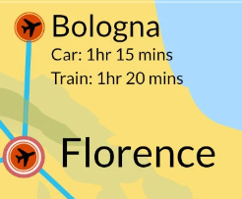
Info how to reach us (from your place to Florence)
Closest Airports to Florence
Florence has its own airport, commonly called "Peretola", but it can also be reached easily from Pisa and Bologna (with High-speed train from Bologna station: 35 minutes trip).

Slide 6
Info how to reach us (from FLR airport to Florence)
If you land in Florence Airport, the "Aeroporto Amerigo Vespucci" the easiest way to get into the city center is through the tram route, the T2, which runs between Florence Peretola airport and Santa Maria Novella train station. Trams run from the airport between 5am and midnight (Sunday-Thursday) and until 1.30am Friday and Saturday, departing every 6-7 minutes at peak times with a journey time of around 20 minutes.
Tickets cost €1.50 and must be bought from the machines at each tram stop. See gestramvia.com for further information.
See: https://www.aeroporto.firenze.it/en/the-passengers/transport/tramway.html

Slide 7
Info how to reach us (from PSA airport to Florence)
The Pisa International Airport brings Tuscany closer to your world: the airport, located along the coast at only 1 km from the city of Pisa, is accessible from the A11 and A12 motorways, from the Florence-Pisa-Livorno highway, from the normal city roads, and from the railway network.
The Pisa Airport is about 1 km from Pisa Centrale railway station, from which you can reach Florence Santa Maria Novella railway Station which is in the city center and in front of Tuscany Region Building (Miriana’s office) and 10 minutes walk from the GA and Board Building (Palazzo Sacrati)
At less than 40 meters from the Passenger Terminal at the Pisa Airport, you can find the new, high-speed, fully automatic People Mover service for direct connections between the Pisa Centrale railway station and the airport. The service is available every day from 6:00 AM to 00:00 AM .
At the airport, bus tickets may be purchased at the Information Desk (Arrivals Area) as an alternative way to reach Florence. The Bus Area (P6) is located just outside the Passenger Terminal Arrivals Area.
See: https://www.pisa-airport.com/en/the-passengers/transport.html

Slide 8
Info how to reach us (from BLG airport to Florence)
Bologna central station
The train station is located 6 km from the airport and is connected to the airport via monorail train - Marconi Express and taxis. Bologna train station is an important railway hub, connecting Bologna to Florence with conventional and high-speed trains (35 minutes trip).
See: https://www.bologna-airport.it/en/from-and-to-the-airport/transfer-from-and-to-the-airport/trains-from-and-to-bologna/?idC=62442

Slide 9
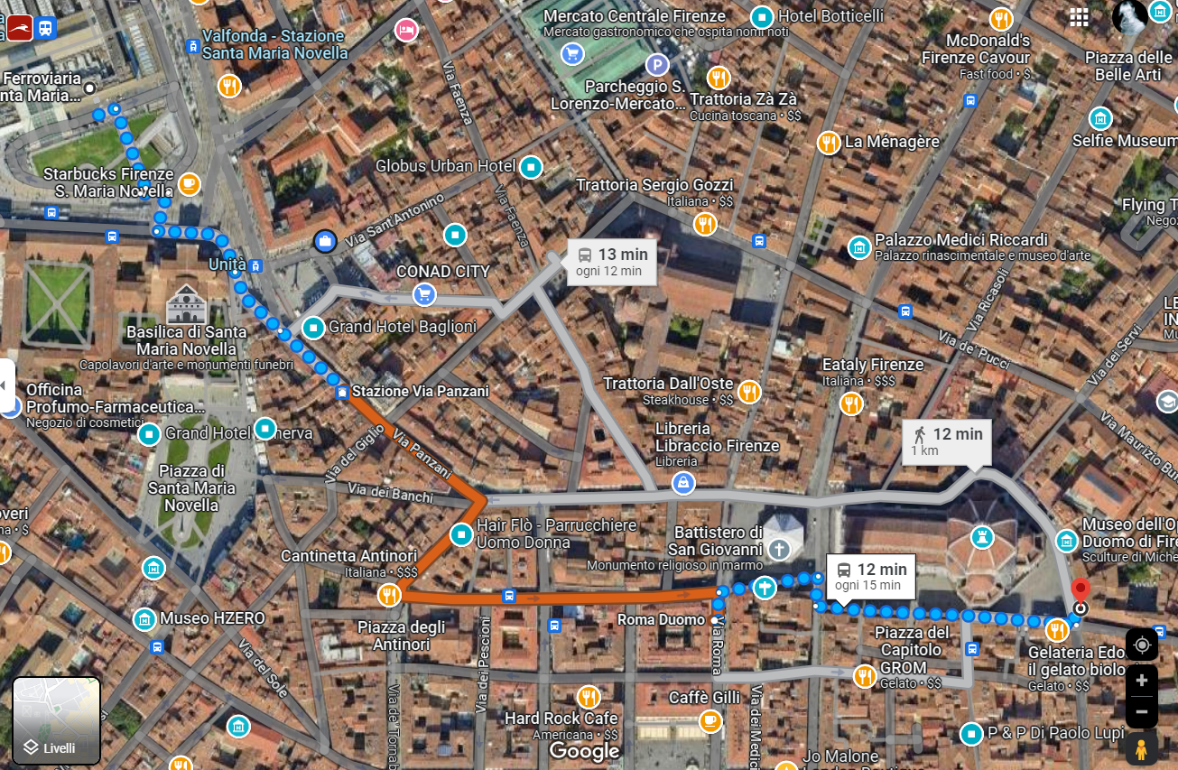
Info Hotels when in Siena
Choosing your hotel in Florence
You can use the Booking website or app. We suggest to book in the city center among the alternatives such as hotels and bed and breakfast.
Consider that we will meet at Palazzo Sacrati Guadagni in the city center
Santa Maria Novella Railway Station
RT IFRL Department
Palazzo Sacrati Guadagni – GA and Board

Slide 10
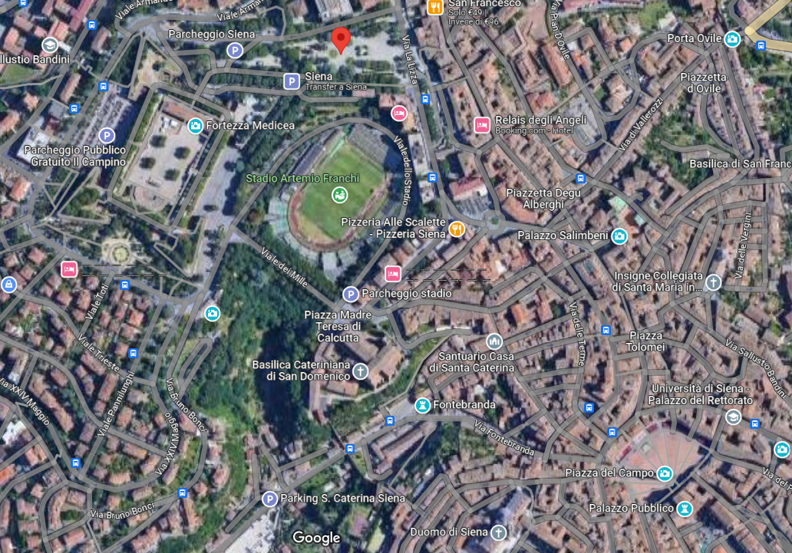
Info Hotels when in Siena
Giardini La Lizza
Choosing your hotel in Siena
You can use the Booking website or app. We suggest to book in the city center among the alternatives such as hotels and bed and breakfast.
Siena is built on three hills and is divided into three Terzi (Parts): Camollia, Città and San Martino and the city is accessed through the doors opened in the walls. It ha a nice pedestrian historic centre, where private cars cannot access and the best way to visit it is on foot
Consider that we will meet at Giardini la Lizza to move to other locations. See: https://goo.gl/maps/hkUBk7FGFHTT1cNv6

Slide 11
Check on our official channel for more info on Tuscany:
https://www.visittuscany.com/it/
See you in Florence
and stay tuned for further updates on the workshop!

Slide 12
Contacts
Regione Toscana
Settore Apprendistato e Tirocini
Miriana Bucalossi
Resp. PO Programmazione Tirocini e Apprendistato. Gestione Progetti Europei e Reti Transnazionali
miriana.bucalossi@regione.toscana.it

