Slide 1
DGI Vestjylland
Presentation at YESpecialists 26-10-2021

Slide 2
Agenda:
Presentation
The concept of village-clusters (landsbyklynge)
Youth and communities
Young people living in village-clusters
Thank you for today ☺

Slide 3
About DGI
Founded in 1992
NGO
Our goal: creating a community which encourages people to join the local sport clubs and sport associations in which the individual can thrive
More than 25 different sports and activities
5 action areas (Children, Youth, Adults, Seniors, Sport Arena)
Notes:
Health, Inclusion, Street sports, Senior sports, Educational institutions, Outdoor sports
- Andreea

Slide 4
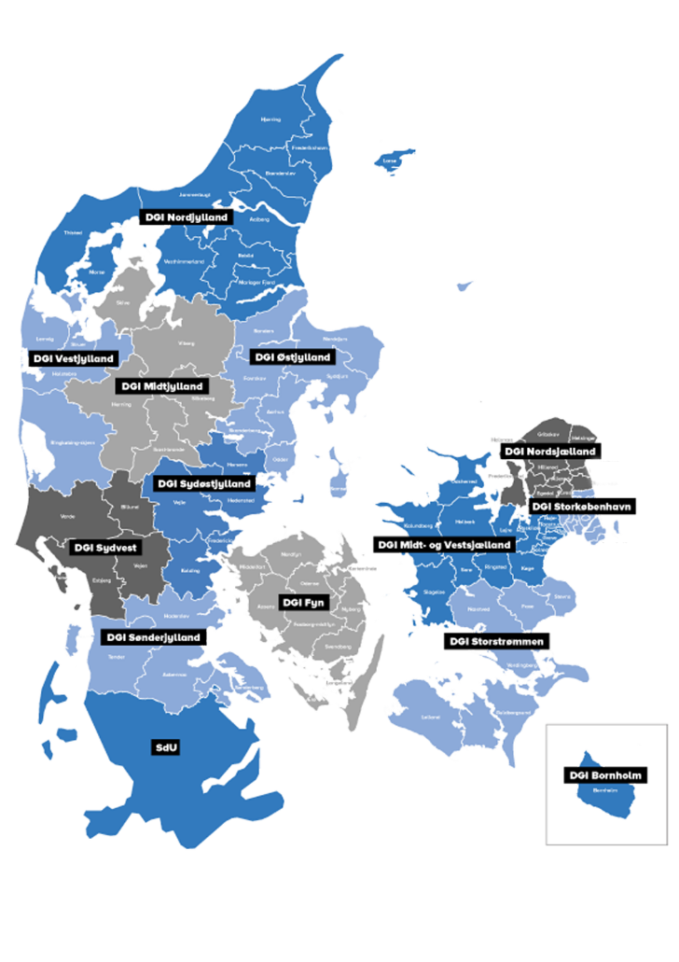
DGI is split up in 14 regions
DGI Vestjylland covers 4 municipalities (Struer, Lemvig, Holstebro, Ringkøbing-Skjern)
DGI Vestjylland has 65.029 members. These members are engaged in 280 sport clubs.
We arrange over 500 events on a year basis
Notes:
We collaborate with local authorities when it comes to keeping people healthy and active. For example we just signed a deal with Holstebro municipality regarding the vision for the next 7 years. Part of the vision was the highway race where aprox. 7000 people participated.

Slide 5
Andreea Elena Oprea
Working with:
Inclusion
Local development
Health
Fundraising
Project management
Experience:
Projekt Manager– DGI Vestjylland
Master Aalborg University – European Studies and International Relations
Bachelor i Leadership and public administration

Slide 6
Cluster-villages
- Collaboration project between DGI, Realdania, LOA & local authorities

Slide 7
Background
Rural areas across the country are in the midst of the biggest change in recent times:
The structural development
urbanization and increased pressure to adapt the municipal service
New forms of community
from the traditional (duty-oriented, inherited, bound to a place, closed with a fixed framework) to modern (desire-oriented, optional, linked to relationships, often interactive, flexible and spontaneous and often time-limited)
Association life (Free time associations)
the pressure on finances, facilities, leaders, volunteers and members
Instead of each village managing itself, the villages can collaborate in Village Clusters and utilize human and physical resources cross sectors

Slide 8
Cluster-villages
Objectives:
To support the establishment of up to 25 new village cluster collaborations
To strengthen rural life
Citizens in several villages cooperate, prioritize and set common long-term and strategic goals for the entire cluster in collaboration with the municipality.
Notes:
Parterne inviterer nu til etablering af op mod 25 landsbyklynger – med henblik på at understøtte nye samarbejder på tværs af landsbyer og herigennem styrke livet på landet
I de enkelte processer er formålet, at borgere i flere landsbyer samarbejder, prioriterer og opstiller fælles langsigtede og strategiske mål for hele klyngen i samarbejde med kommunen.
Fokusområder
Etablering af en fælles organisering, der koordinerer på tværs af landsbyer og kendte strukturer
Etablering af en styrket og koordineret kommunikationsindsats
Involvering af borgerne via spørgeskemaundersøgelser, borger- og dialogmøder samt etablering af arbejdsgrupper.
Etablering af et styrket samarbejde med kommunen, så borgere og kommune i fællesskab kan optimere den kommunale service.

Slide 9
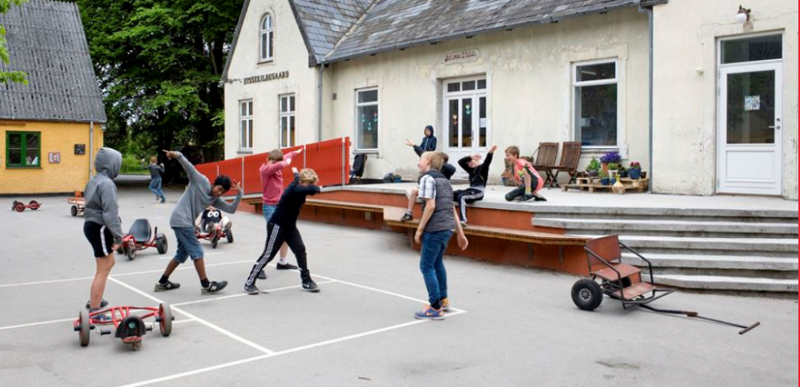
Cluster-villages
Focus areas:
Establishment of a common organization that coordinates across villages. Establishment of a strengthened and coordinated communication effort.
Involvement of citizens through questionnaires, surveys, dialogue meetings and the establishment of working groups.
Establishment of a strengthened collaboration with the municipality, so that citizens and the municipality can jointly optimize the municipal service.
Notes:
Parterne inviterer nu til etablering af op mod 25 landsbyklynger – med henblik på at understøtte nye samarbejder på tværs af landsbyer og herigennem styrke livet på landet
I de enkelte processer er formålet, at borgere i flere landsbyer samarbejder, prioriterer og opstiller fælles langsigtede og strategiske mål for hele klyngen i samarbejde med kommunen.
Fokusområder
Etablering af en fælles organisering, der koordinerer på tværs af landsbyer og kendte strukturer
Etablering af en styrket og koordineret kommunikationsindsats
Involvering af borgerne via spørgeskemaundersøgelser, borger- og dialogmøder samt etablering af arbejdsgrupper.
Etablering af et styrket samarbejde med kommunen, så borgere og kommune i fællesskab kan optimere den kommunale service.

Slide 10
Target group: Municipalities with villages that want to strengthen quality of life and local development through cooperation Method: - Citizen-driven commitment and initiatives - Municipal support - External competencies that can inspire and drive the process - Knowledge of the municipality's need for service adaptation - Analyses of the citizens' needs - Broad involvement
Cluster-villages
Notes:
I forhold til målgruppen og deres ansøgninger vil der blive lagt vægt på
Landdistriktsrelaterede udfordringer – der nødvendiggør en omstilling og tilpasning og motiverer udviklingen af en landsbyklynge
Stedsspecifikke muligheder - der kan danne udgangspunkt for udviklingen
Enhed – geografisk, identitetsmæssigt eller historisk – at der kan argumenteres for klyngens afgrænsning
Stærk motivation - mangfoldighed af lokale aktører der står bag
At er skabes synergi med øvrige initiativer og planer i kommunen

Slide 11
- 37 cluster-villages in Denmark - Plenty of materials from their work (videos, methods, reports, analyses, evaluations and so on) - 3 cluster-villages in Ringkøbing-Skjern municipality
Cluster-villages – situation today
Notes:
I forhold til målgruppen og deres ansøgninger vil der blive lagt vægt på
Landdistriktsrelaterede udfordringer – der nødvendiggør en omstilling og tilpasning og motiverer udviklingen af en landsbyklynge
Stedsspecifikke muligheder - der kan danne udgangspunkt for udviklingen
Enhed – geografisk, identitetsmæssigt eller historisk – at der kan argumenteres for klyngens afgrænsning
Stærk motivation - mangfoldighed af lokale aktører der står bag
At er skabes synergi med øvrige initiativer og planer i kommunen

Slide 12
Exercise:
Do you have cluster-villages in your country/municipality?
Could cluster-villages help solve some of the local challenges you experience in your municipality?
Notes:
15.00

Slide 13
Youth and communities
Insigths from DGI

Slide 14
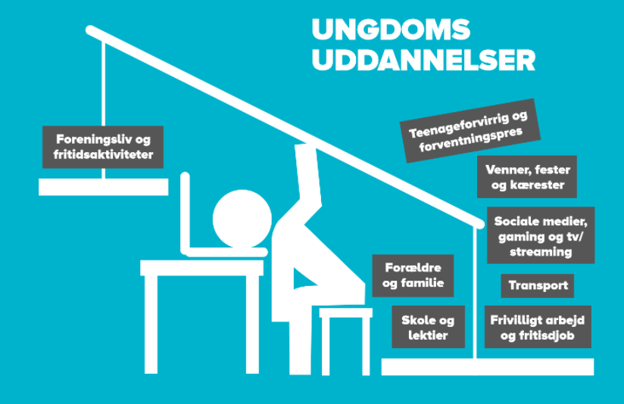
It’s all about balance…

Slide 15
Young people as volunteers
41% of the 15-30 year olds performed volunteer work.
39% of young people want to volunteer - of which 36% intend to start within the next six months
Would prefer to volunteer for other young people
They would like to prioritise:
Companionship (to be together with other young people)
Self-realization (they get the chance to start something new)
The cause (values, the good life and the good society)
Obligation towards each other

Slide 16
The highly motivated young people
The entrepreneurial type who want to create something for others
Have topics they are passionate about
Knowledge desire and interest
Experiences with mastery and success
Make a difference and make an impression on the world
Relationships that push, recognize and have expectations of them
New communities where you share and help each other
Sees himself as more outgoing and with larger networks
Motivated by financial incentives: start-up amount to launch a project

Slide 17
How to engage young people
Use knowledge and numbers regarding the youth
Start early dialogue and involve them
Which initiatives we have right now and what do the youngsters want?

Slide 18
Young people in cluster-villages
Methods and ideas

Slide 19
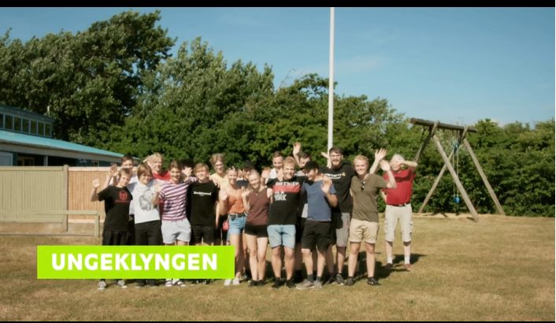
Baggrund for projektet
The village clusters want to collaborate with young people!
The young cluster in Sdr. Nissum as pilot project
Social inequality in youth life

Slide 20
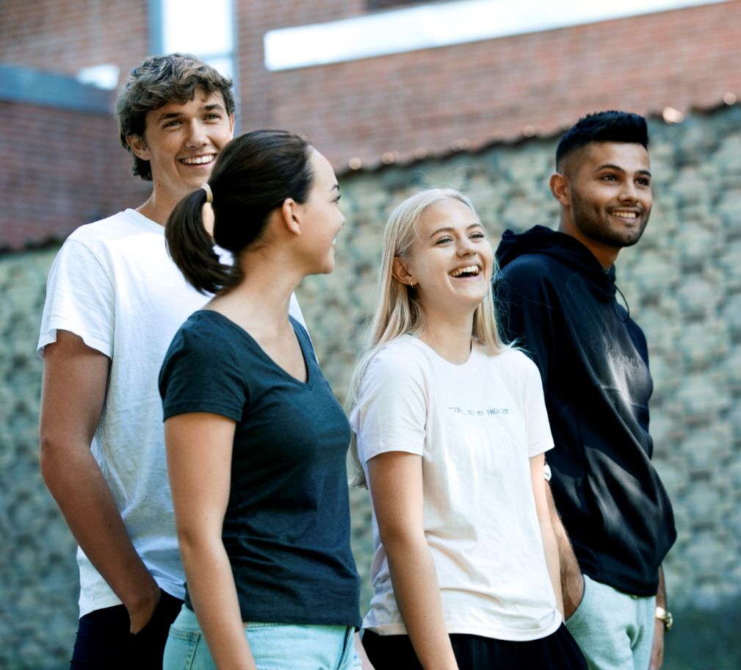
Objectives
Constructive youth communities defined and run by the young people themselves
New offers and activities - at the young people's wishes and initiatives
A positive story about youth life in outlying areas
Method development: When is it interesting for young people to get involved?
Notes:
VI skal huske at sige lidt om landsbyklynger.. Som baggrund

Slide 21
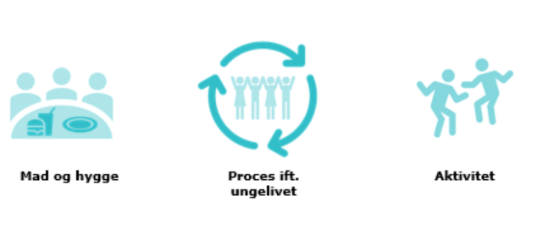
Target group:
Young people between 15-25 (across interests, resources and villages)
How to work with the initiative:
The young as experts!
We do not set goals in advance - the goals are set by the young people
Place for different forms of participation
Food and coziness
Activities
Process regarding the youth life
Notes:
Vigtigt fokus ift. ungegruppen

Slide 22
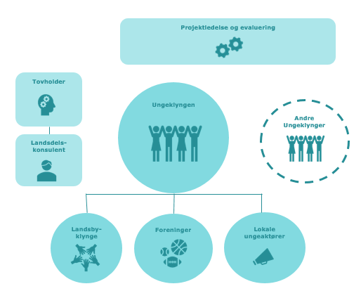
Organisation
Project management and evaluation
The young cluster
The person responsible
Other young clusters
DGI Consultant
Local stakeholders working with the youth
Cluster-Villages Committee
Associations

Slide 23
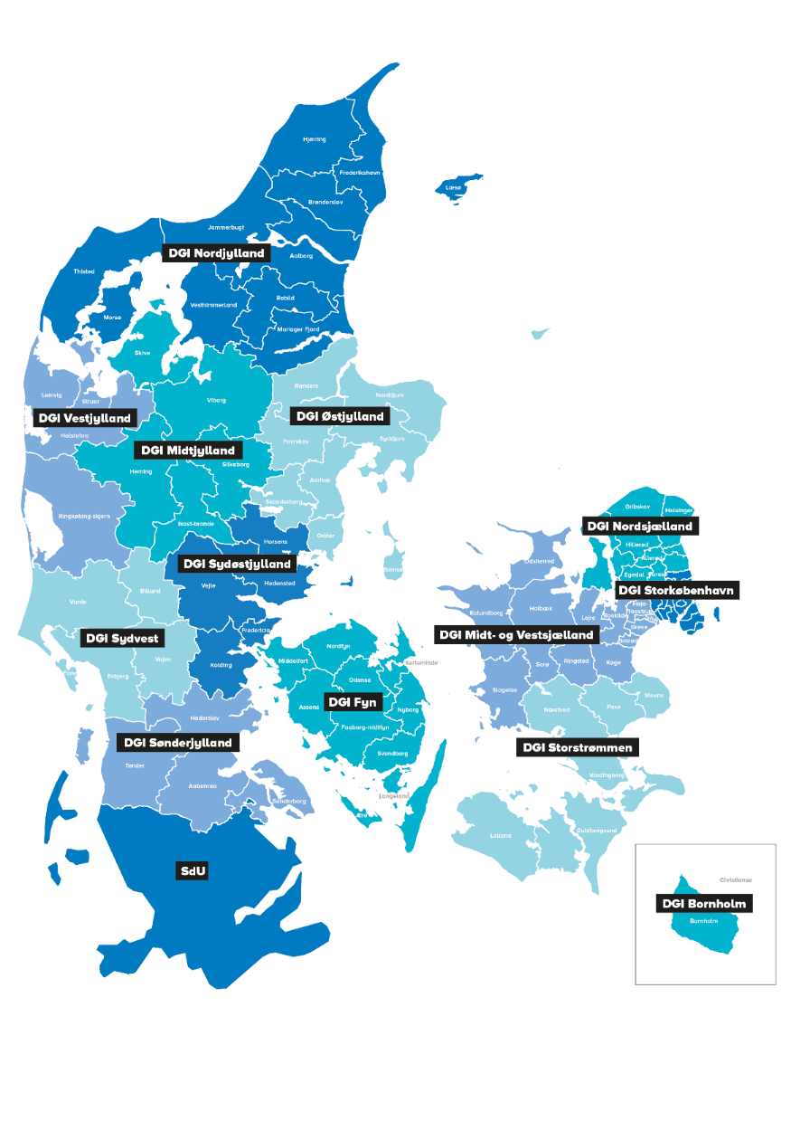
Where are the young clusters to be found?
Klynge 1: Midt i Norddjurs
Vesterhavsklyngen (Holstebro)
Bedst mod West (Ringkøbing-Skjern)
Klynge 2: Landsby-fællesskabet Østdjurs
Klynge 3: Friskvind (Ringkøbing-Skjern)
Klynge 5: Hærvejsklyngen (Vejen)
Klynge 4: Landet mellem byerne (Næstved)
Hånden under Midtfyn (Faaborg Midtfyn))

Slide 24
Maturation of the local area
Purpose: Preparation, understanding, ownership and mapping
Pre-process with young people
Purpose: Ownership, motivation and relevance
Why do young people need the cluster?
Anchoring the results
Purpose: Youth focus in clusters and communities
Activity-based start-up with young people
Purpose: Invite young people in and start the dialogue
Why does the cluster need the young people?
Interaction with the local area
Purpose: Greater awareness, more activities and young people in local processes
Identity and core narrative
Purpose: Building youth communities and identity
Notes:
Midten: Vigtigt at tydeliggøre, hvorfor de unge er vigtige - hvad kan de bidrage med? (at være ung er ikke i sig selv nødvendigvis meritgivende – set fra et ungeperspektiv)

Slide 25
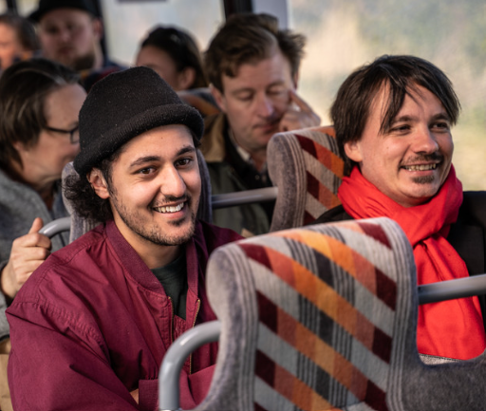
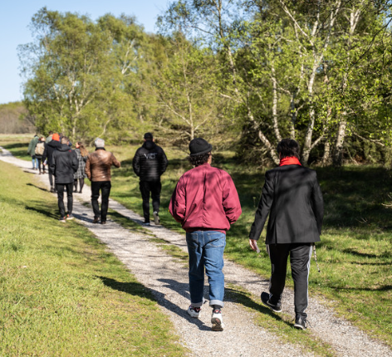
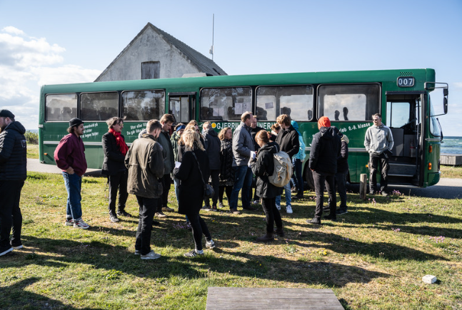
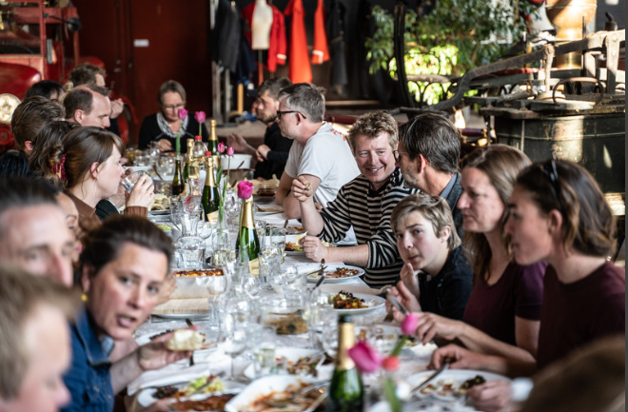
Bus and bubbles in Norddjurs
Focus on: Increased knowledge of the area, the social aspect, dialogue between young people and former young people
https://www.youtube.com/watch?v=2PKAKvSlRLE
Notes:
Investér lige meget energi i arbejdet med omverdenen som i det direkte arbejde med unge
Hav positive forventninger til unge og tro på deres engagement - vær klar til at understøtte
Skab konkrete anledninger med mulighed for forskellige deltagelsesformer
Skab rum for løbende dialog med de unge om deres engagement

Slide 26
Other ideas…
A bus that drives around and visits places in the local area - associations, nature areas, creative workshops, etc. The bus is full of young people and former young people and there is lots of conversation along the way and dining at the end.
An event where young people present an idea (which will contribute to increase the community feeling / develop and activity / improve the well-being for young people) for a panel, and can get DKK 5,000 to bring the idea to life.
Young people contribute to mapping the village focusing on meeting places for young people. They map the area by taking pictures of all the ‘young’ places
Young people take over a meeting place and a process is run in which the young people themselves decorate and build

Slide 27
Collection of good advices at the end
Invest as much energy in the work with the outside world as in the direct work with young people
Have positive expectations of young people and believe in their commitment - be ready to support
Create the possibility of different forms of participation
Create space for ongoing dialogue with young people about their commitment
The process it must be user-driven and citizen-involved - what we work with is what the young people want and what they have the resources for
It is important to have an “adult” who can support the young people in their projects
It is crucial to work with activities early in the process - you must work with both the process and with activities (none of the parts can stand alone)
Make sure to focus on how to ensure sustainability and anchoring right from the start

Slide 28
Exercise:
How do you plan to engage young people in your initiatives?
What methods will you use to ensure active participation?

Slide 29
Contact information
Andreea Oprea
Projekt Manager
E-mail: andreea.oprea@dgi.dk
DGI Vestjylland
Mobil: 21 47 14 02

Slide 30
Thank you for today ☺

